Slide 1
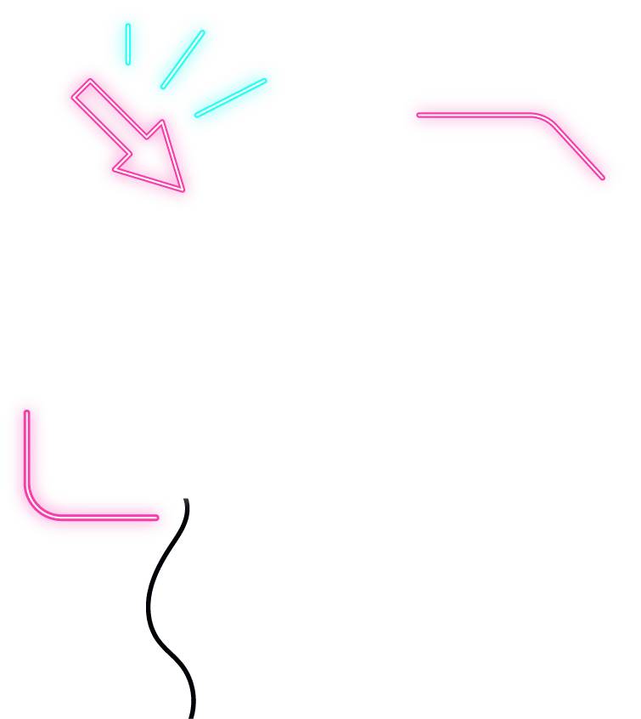






IOT WORKLOAD CHARACTERIZATION IN NEXT GENERATION CLOUD SYSTEMS UPDATE
Supervised by: Dr. Karan Mitra, Dr. Saguna Saguna,
Dr. Christer Åhlund
Presented by: Fatema Mirza

Slide 2






Latest additions
TABLE OF CONTENTS
fatmir-0@student.ltu.se

Slide 3
01
Latest additions
fatmir-0@student.ltu.se

Slide 4
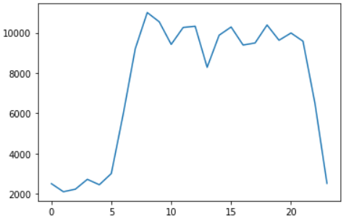
Original Data for aggregated hourly
fatmir-0@student.ltu.se 25/02/2022 | 07

Slide 5
ARIMA
AR: Autoregression. A model that uses the dependent relationship between an observation and some number of lagged observations.
I: Integrated. The use of differencing of raw observations (e.g. subtracting an observation from an observation at the previous time step) in order to make the time series stationary.
MA: Moving Average. A model that uses the dependency between an observation and a residual error from a moving average model applied to lagged observations.

Slide 6
ARIMA
The parameters of the ARIMA model are defined as follows:
p: The number of lag observations included in the model, also called the lag order.
d: The number of times that the raw observations are differenced, also called the degree of differencing.
q: The size of the moving average window, also called the order of moving average.

Slide 7
ARIMA
Auto Correlation Function (ACF)
The correlation between the observations at the current point in time and the observations at all previous points in time. We can use ACF to determine the optimal number of MA terms or q. The number of terms determines the order of the model.
Partial Auto Correlation Function (PACF)
As the name implies, PACF is a subset of ACF. PACF expresses the correlation between observations made at two points in time while accounting for any influence from other data points. We can use PACF to determine the optimal number of terms to use in the AR model or p. The number of terms determines the order of the model.

Slide 8
ADF
#Ho: It is non-stationary
#H1: It is stationary
We will be considering the null hypothesis that data is not stationary and the alternate hypothesis that data is stationary.

Slide 9
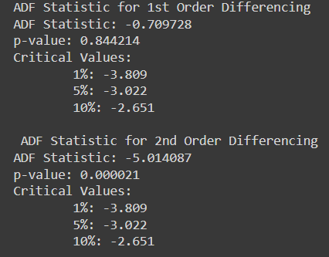
ADF statistics
Here P-value is 0.84 which is greater than 0.05, which means data is accepting the null hypothesis, which means data is non-stationary for 1st order differencing.
Here P-value is 0.000021 which is less than 0.05, which means data is accepting the alternate hypothesis, which means data is stationary for 2nd order differencing.
Hence we can use d order of 2, also confirmed from the graph.
fatmir-0@student.ltu.se 25/02/2022 | 07

Slide 10

ADF, KPSS, PP Test
Augmented Dickey Fuller test (ADF Test) is a common statistical test used to test whether a given Time series is stationary or not.
Kwiatkowski–Phillips–Schmidt–Shin (KPSS) tests are used for testing a null hypothesis that an observable time series is stationary around a deterministic trend (i.e. trend-stationary) against the alternative of a unit root.
Phillips–Perron is a unit root test used in time series analysis to test the null hypothesis that a time series is integrated of order 1.
From the test we can see that the d value is to be 2.
fatmir-0@student.ltu.se 25/02/2022 | 07

Slide 11
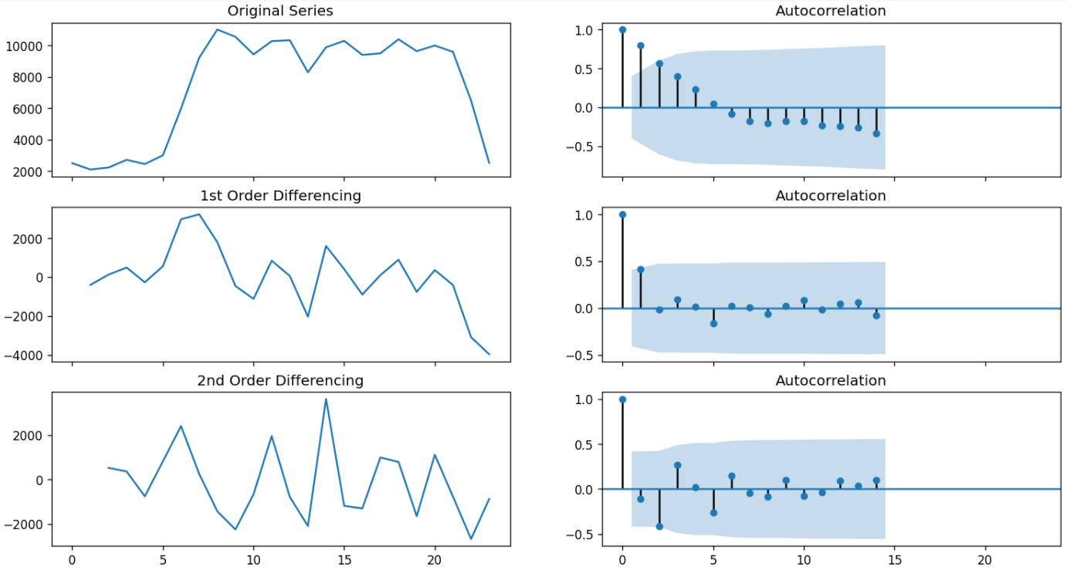
To find p,d and q for ARIMA
fatmir-0@student.ltu.se 25/02/2022 | 07

Slide 12
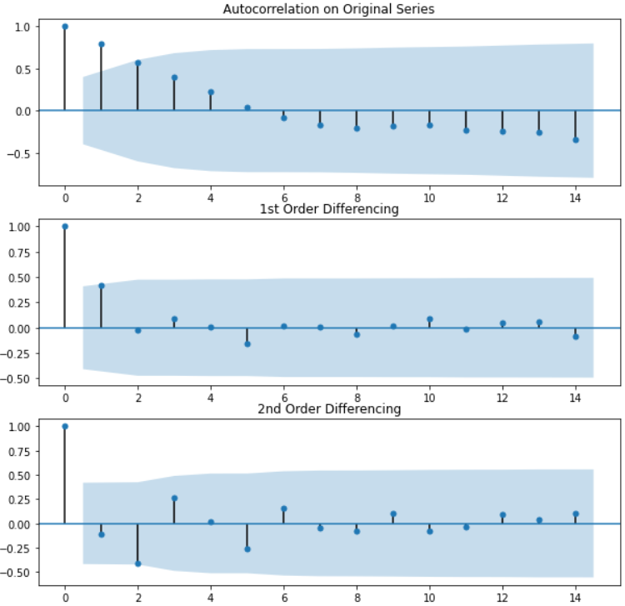
To find p,d and q for ARIMA
For 2nd order differencing, we can see that the values fall under the significance level so p =2
fatmir-0@student.ltu.se 25/02/2022 | 07

Slide 13
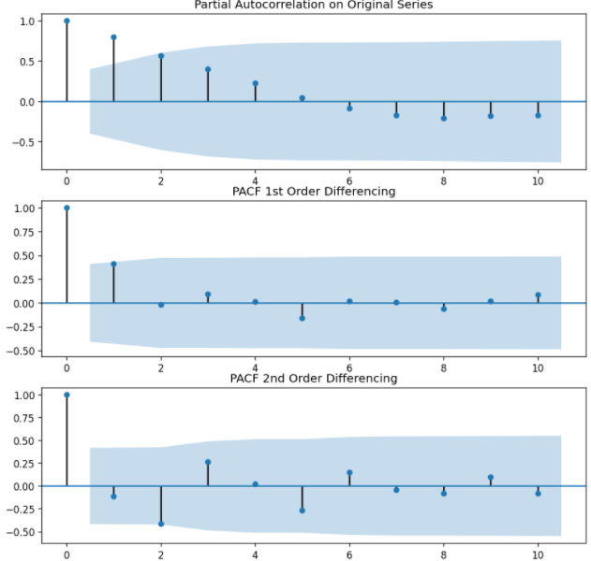
To find p,d and q for ARIMA
1st order seems to be better here, so q =1, since it falls under the significance and not too many negative values which might indicate over differenced
fatmir-0@student.ltu.se 25/02/2022 | 07

Slide 14
ARIMA (2,2,1)
From all the tests and graphs conducted, we can assume that Arima or the order p=2, d=2 and q=1 will work best.
fatmir-0@student.ltu.se 25/02/2022 | 07

Slide 15
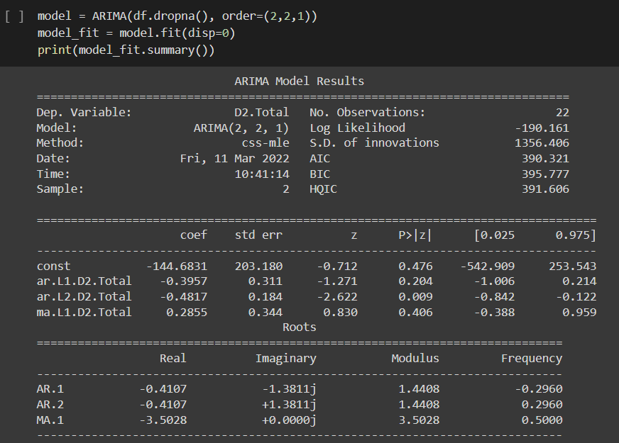
Arima (2,2,1)
fatmir-0@student.ltu.se 25/02/2022 | 07

Slide 16
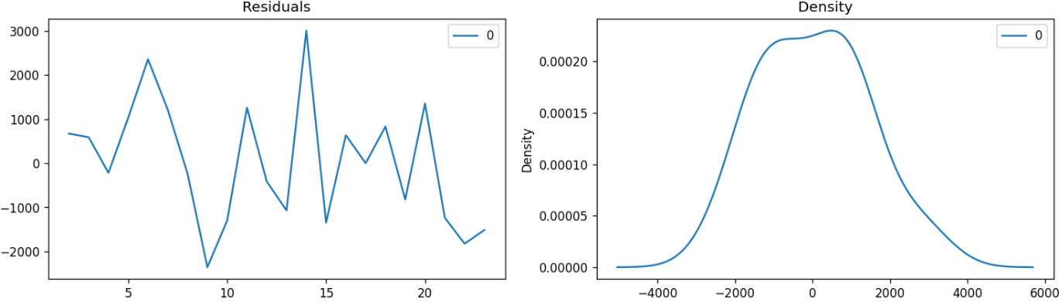
Residuals
Residuals seem to be normally distributed, which validates the ARIMA(2,2,1) model.
fatmir-0@student.ltu.se 25/02/2022 | 07

Slide 17
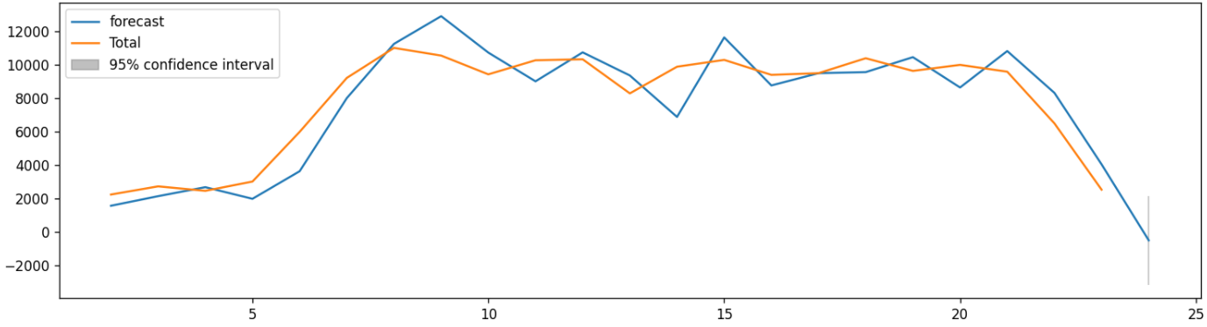
Results for hourly
fatmir-0@student.ltu.se 25/02/2022 | 07

Slide 18
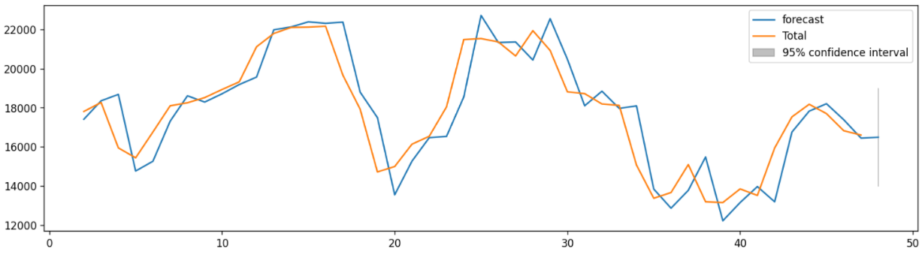
Results for half hourly
fatmir-0@student.ltu.se 25/02/2022 | 07

Slide 19
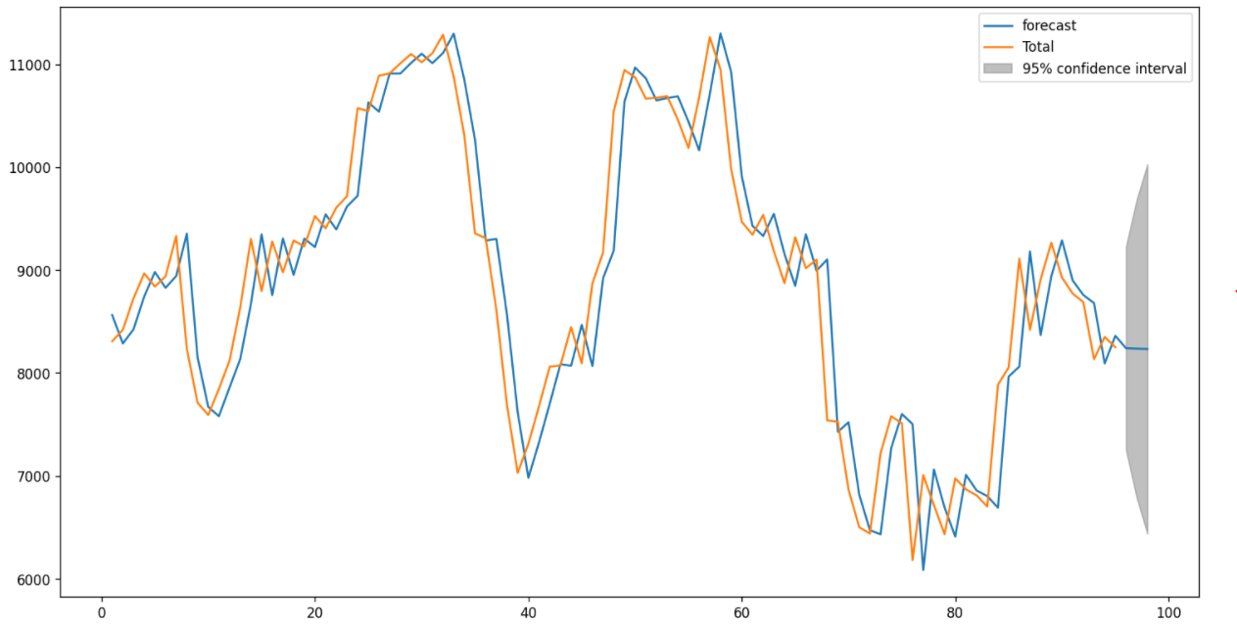
Results for 15 minutes
Notes:
Look at autocorrelation function – moving standard deviation
Class of algo considered – time series data (supervcised – all the model we have done so far) reflect
Chapter 2 table of taxonomy – c1 (paper and author) , prob, year, time resolution, type of model, workload, use case
Random forest - LSTM
No need for complex models (research)

Slide 20
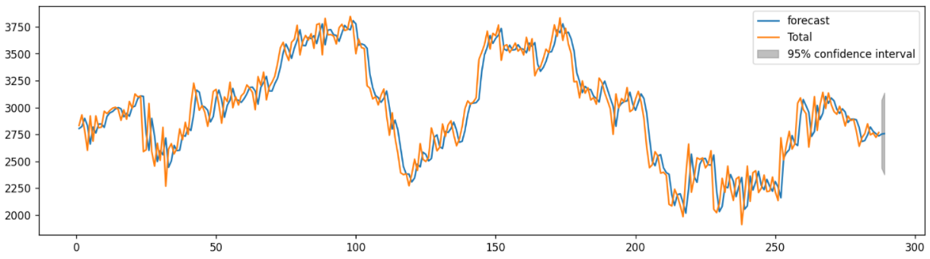
Results for 5 minutes

Slide 21
Next steps
Do the one minute interval (which is going on at the moment – code is running)
Use MAE, MSE, RMSE to validate the results
Find the ARIMA equations
Look a bit more into common distribution to fit the data
Write about this ARIMA part

Slide 22

Thank you! Tack så mycket
Any Questions?
fatmir-0@student.ltu.se

Slide 23
References
[1] https://www.youtube.com/watch?v=SqSUJ0UYWMQ
[2] https://techcrunch.com/2014/11/08/littles-law-is-big-for-startups/?guccounter=1&guce_referrer=aHR0cHM6Ly93d3cuZ29vZ2xlLmNvbS8&guce_referrer_sig=AQAAAFvY4BNr5Vvu2uDhXO4VTDuLiVSsISoGSjMxJMxW1Pt6ar11_kEY1wq5aw5HlXlySpE0jUAVwaZrqBu00JlSq7EUCeucjIMrTrHpRp59P000WKfozg64v5gANPPBZ1cB1W72iB8KG7aZ9xlUhU3E68QBMT2CsMngoCUV5UZ2HcNW
[3] Konstantopoulos, T. A review of Burke’s theorem for Brownian motion. Queueing Syst 83, 1–12 (2016). https://doi.org/10.1007/s11134-016-9478-x
[4] Chen H., Yao D.D. (2001) Jackson Networks. In: Fundamentals of Queueing Networks. Stochastic Modelling and Applied Probability, vol 46. Springer, New York, NY. https://doi.org/10.1007/978-1-4757-5301-1_2
[5] M. López-Benítez, C. Majumdar and S. N. Merchant, "Aggregated Traffic Models for Real-World Data in the Internet of Things," in IEEE Wireless Communications Letters, vol. 9, no. 7, pp. 1046-1050, July 2020, doi: 10.1109/LWC.2020.2980272.
[6] M. López-Benítez, C. Majumdar and S. N. Merchant, "Aggregated Traffic Models for Real-World Data in the Internet of Things," in IEEE Wireless Communications Letters, vol. 9, no. 7, pp. 1046-1050, July 2020, doi: 10.1109/LWC.2020.2980272.
[7] ing Yuan, Yu Zheng, Chengyang Zhang, Wenlei Xie, Xing Xie, Guangzhong Sun, and Yan Huang. Tdrive: driving directions based on taxi trajectories. In Proceedings of the 18th SIGSPATIAL International
Conference on Advances in Geographic Information Systems, GIS ’10, pages 99{108, New York, NY, USA,
2010. ACM.
[8] Huang, Jiwei & Li, Songyuan & Chen, Ying & Chen, Junliang. (2018). Performance modelling and analysis for IoT services. International Journal of Web and Grid Services. 14. 146. 10.1504/IJWGS.2018.090742.
[9] Tran-Gia, Phuoc & Hossfeld, Tobias (2021). Performance Modeling and Analysis of Communication Networks
- A Lecture Note. Würzburg University Press. https://doi.org/10.25972/WUP-978-3-95826-153-2
fatmir-0@student.ltu.se 11/02/2022 | 11

